Slide 1
Session – 10
Agile

Slide 2
Topics
Simple Practices and Project Tools
Empirical vs. Defined & Prescriptive Process
Principle-Based versus Rule-Based
Agile Hype?
Specific Agile Methods

Slide 3
Simple Practices and Project Tools
Simplicity—the art of maximizing the amount of work not done—is essential.
List Of The Best Agile Project Management Tools
Monday.com
Nifty
Wrike
SpiraTeam
Atlassian Jira
Active Collab
Agilo for Scrum
SpiraTeam
Pivotal Tracker
VSTS
Icescrum
Gravity
SprintGround
VersionOne
Taiga

Slide 4
Empirical vs.
Defined & Prescriptive Process
In general, agile methods promote empirical rather than defined processes.
A defined process (also known as a prescriptive process) are suitable for predictable manufacturing domains.
Empirical processes are used for high-change and unstable domains.

Slide 5
Principle-Based vs.
Rule-Based
Agile methods are more principle-based than rule-based.

Slide 6
Agile Methods
Scrum
XP
Crystal Methods
Other Methods and Practices
Adaptive Software Development
Dynamic Solution Delivery Model
Feature Driven Development
Lean Development
Pragmatic Programming

Slide 7
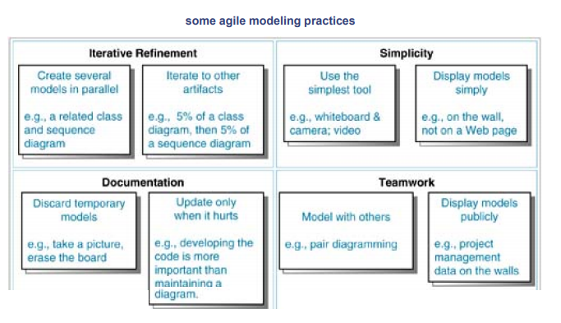
Agile Modeling

Slide 8
Questions
List out Various Agile project Management Tools and explain working functionality.
Differentiate between Empirical processes and defined process
Define principle based approach and rule based approach?
Agile Methods are Invent Iterative Development or not? Justify.
Write Short notes about Agile methods.
Compare and contrast Scrum and XP.

